Slide 1
AZ-400.00 Learning Path 01: Implement development for enterprise DevOps

Slide 2
Agenda
Module 01: Introduction to DevOps.
Module 02: Plan Agile with Azure Boards.
Module 03: Plan Agile with GitHub Projects.
Module 04: Source Control
Module 05: Plan foster inner source.
Module 06: Manage and configure repositories.
Labs.

Slide 3
Learning objectives
After completing this Learning Path, students will be able to:
1
Explain how to structure Git Repos
2
Describe Git branching workflows
3
Leverage pull requests for collaboration and code reviews
4
Use GitHub Flow for collaboration

Slide 4
Module 01: Introduction to DevOps

Slide 5
Explore agile development practices
1
Waterfall approach:
Define, analyze, build and test, and deliver
Hard to accurately define requirements, which can change over time, including during development
Requires change requests and additional cost after delivery
2
Agile approach:
Emphasizes constantly adaptive planning, and early delivery with continual improvement
Development methods are based on releases and iterations
At the end of each iteration, should have tested working code
Is focused on shorter-term outcomes
Notes:
x

Slide 6
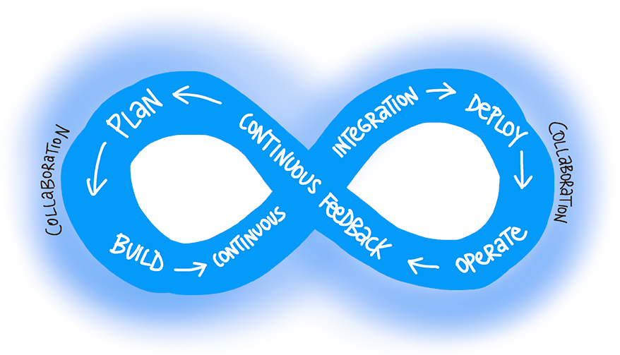
What is DevOps?
“DevOps is the union of people, process, and products to enable continuous delivery of value to end users.”
— Donovan Brown,
What is DevOps?
Notes:
https://docs.microsoft.com/en-us/azure/devops/learn/what-is-devops

Slide 7
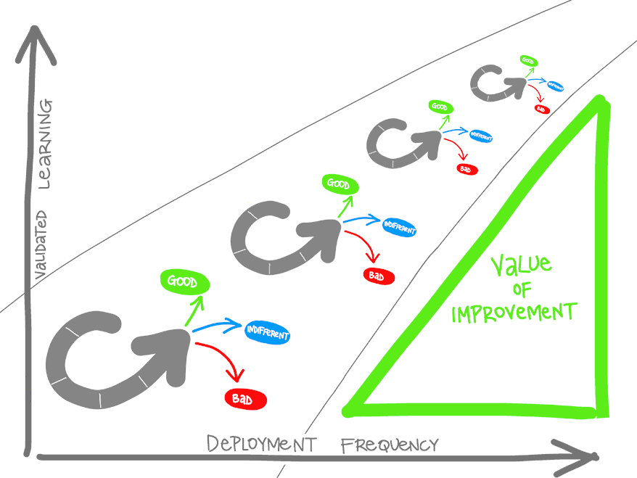
What is DevOps? (continued)
Understand your cycle time
Become data-informed
Strive for validated learning
Shorten your cycle time
Optimize validated learning
Notes:
Wanneer je een nieuw product wilt gaan ontwikkelen, doe je dit vaak op basis van aannames en inschattingen van de behoefte van jouw klant. Om er echter achter te komen waar de daadwerkelijke behoeftes liggen, kan je validated learning toepassen. Validated learning is de methode om op basis van data erachter te komen waar jouw klanten behoefte aan hebben.

Slide 8
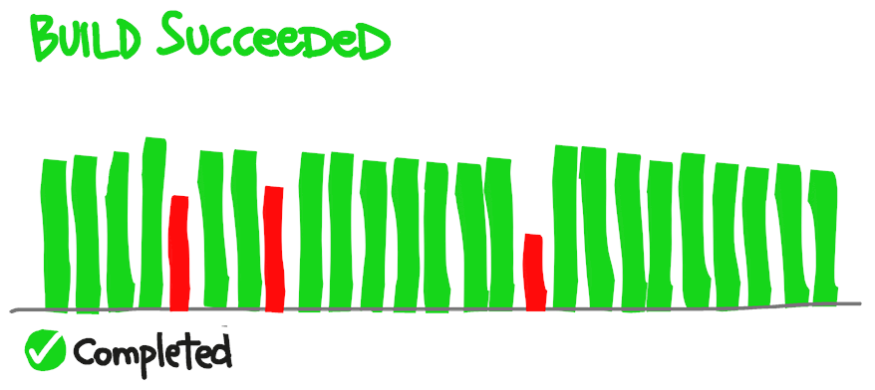
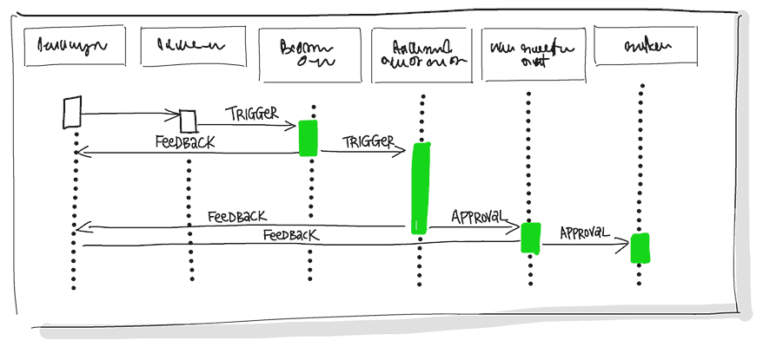
Explore the DevOps journey
Continuous Integration
Continuous Integration drives the ongoing merging and testing of code, which leads to finding defects early.
Continuous Delivery
Continuous Delivery of software solutions to production and testing environments helps organizations quickly fix bugs and respond to ever-changing business requirements.
Notes:
https://docs.microsoft.com/en-us/azure/devops/learn/what-is-devops
https://docs.microsoft.com/en-us/learn/modules/introduction-to-devops/3-explore-devops-journey
Continuous Integration drives the ongoing merging and testing of code, which leads to finding defects early. Other benefits include less time wasted on fighting merge issues and rapid feedback for development teams.
Continuous Delivery of software solutions to production and testing environments helps organizations quickly fix bugs and respond to ever-changing business requirements.

Slide 9
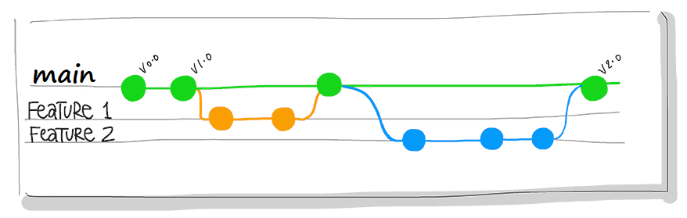
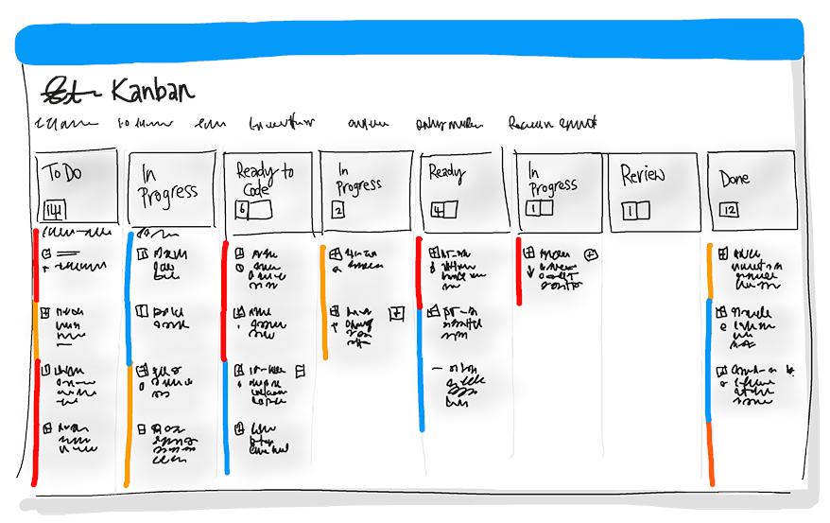
Explore the DevOps journey (continued)
Version Control
Version Control, usually with a Git-based Repository, enables teams located anywhere in the world to communicate effectively during daily development activities.
Agile/lean
Plan and isolate work into sprints.
Manage team capacity and help teams quickly adapt to changing business needs.
A DevOps Definition of Done is working software collecting telemetry against the intended business goals.
Notes:
https://docs.microsoft.com/en-us/azure/devops/learn/what-is-devops
https://docs.microsoft.com/en-us/learn/modules/introduction-to-devops/3-explore-devops-journey
Version Control, usually with a Git-based Repository, enables teams located anywhere in the world to communicate effectively during daily development activities. Also, integrate with software development tools for monitoring activities such as deployments.
Use Agile planning and lean project management techniques to:
Plan and isolate work into sprints.
Manage team capacity and help teams quickly adapt to changing business needs.
A DevOps Definition of Done is working software collecting telemetry against the intended business goals.

Slide 10
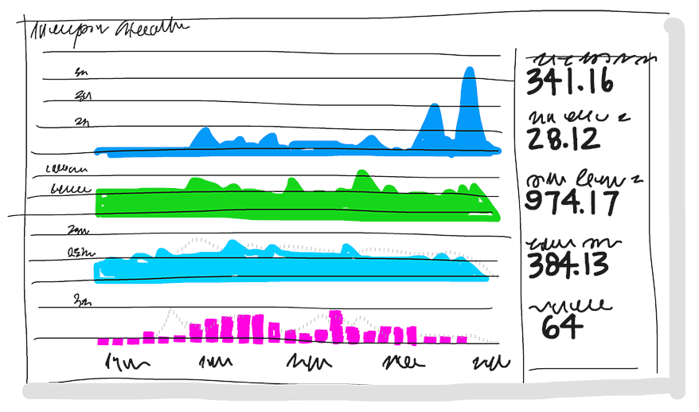
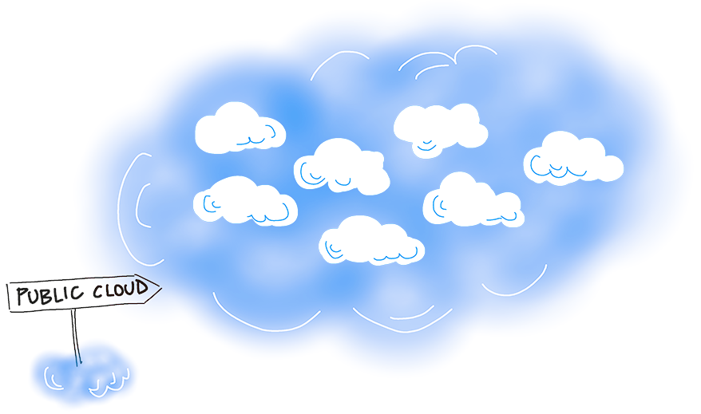
Explore the DevOps journey (continued)
Monitoring and logging
Monitoring and Logging of running applications.
Cloud
Public and Hybrid Clouds have made the impossible easy.
Notes:
https://docs.microsoft.com/en-us/azure/devops/learn/what-is-devops
https://docs.microsoft.com/en-us/learn/modules/introduction-to-devops/3-explore-devops-journey
Monitoring and Logging of running applications. Including production environments for application health and customer usage. It helps organizations create a hypothesis and quickly validate or disprove strategies. Rich data is captured and stored in various logging formats.
Public and Hybrid Clouds have made the impossible easy. The cloud has removed traditional bottlenecks and helped commoditize Infrastructure. You can use Infrastructure as a Service (IaaS) to lift and shift your existing apps or Platform as a Service (PaaS) to gain unprecedented productivity. The cloud gives you a data center without limits.

Slide 11
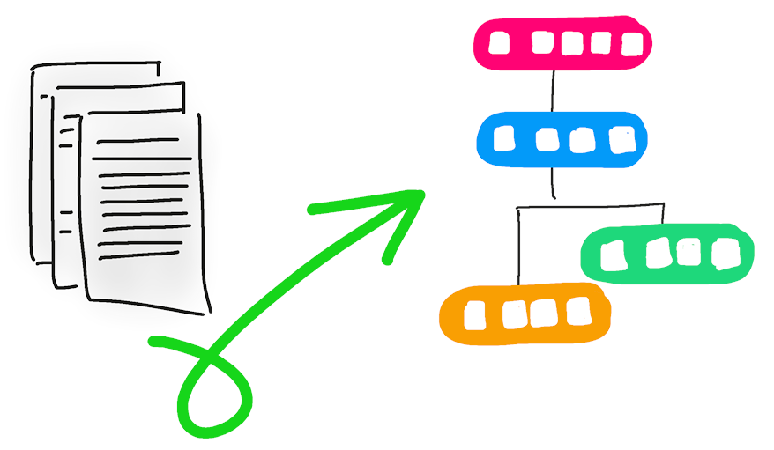
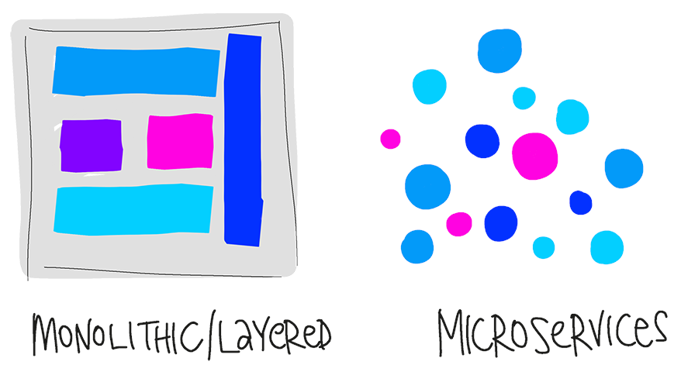
Explore the DevOps journey (continued)
Infrastructure as Code (IaC)
Enables the automation and validation of the creation and teardown of environments to help with delivering secure and stable application hosting platforms.
Microservices
Isolate business use cases into small reusable services that communicate via interface contracts.
Notes:
https://docs.microsoft.com/en-us/azure/devops/learn/what-is-devops
https://docs.microsoft.com/en-us/learn/modules/introduction-to-devops/3-explore-devops-journey
Infrastructure as Code (IaC): Enables the automation and validation of the creation and teardown of environments to help with delivering secure and stable application hosting platforms.
Use Microservices architecture to isolate business use cases into small reusable services that communicate via interface contracts. This architecture enables scalability and efficiency.

Slide 12
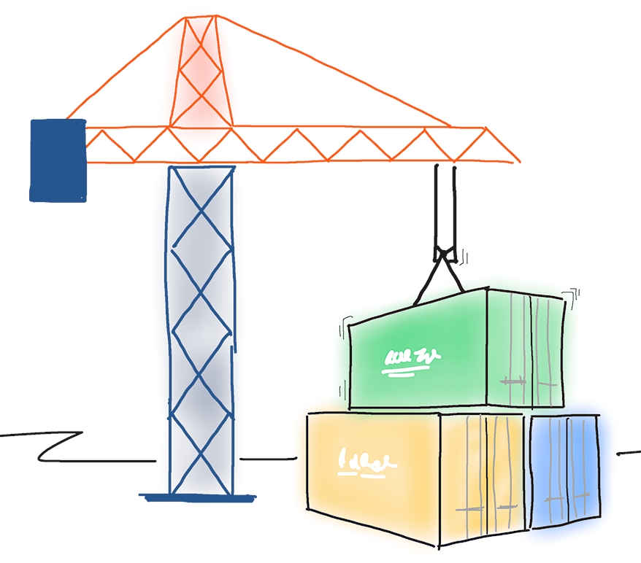
Explore the DevOps journey (continued)
Containers
Containers are the next evolution in virtualization.
DevOps may hurt at first
Notes:
https://docs.microsoft.com/en-us/azure/devops/learn/what-is-devops
https://docs.microsoft.com/en-us/learn/modules/introduction-to-devops/3-explore-devops-journey
Containers are the next evolution in virtualization. They are much more lightweight than virtual machines, allow much faster hydration, and easily configure files.
DevOps may hurt at first.
If it hurts, do it more often. Just like going to the gym, adopting new practices is likely to hurt at first. The more often you exercise the new techniques, the easier they will become.
Like training at the gym, where you first exercise large muscles before small muscles, adopt practices that have the most significant impact. Cross-train to develop synergy.

Slide 13

Define organization structure for agile practices
Horizontal team structures divide teams according to the software architecture.
Vertical teams span the architecture and are aligned with product outcomes, and scaling can occur by adding teams.
Vertical teams have been shown to provide stronger outcomes in Agile projects

Slide 14
What is Azure DevOps?
1
Azure Boards: Agile planning, work item tracking, visualization and reporting tool
2
Azure Pipelines: A language, platform and cloud agnostic CI/CD platform with support for containers or Kubernetes
3
Azure Repos: Provides cloud-hosted private git repos
4
Azure Artifacts: Provides integrated package management with support for Maven, npm, Python and NuGet package feeds from public or private sources
5
Azure Test Plans: Provides an integrated planned and exploratory testing solution

Slide 15
What is GitHub?
1
Codespaces: Provide cloud-hosted collaborative development environments
2
Repos: Provide cloud-hosted and on-premises git repos for both public and private projects
3
Actions: Create automation workflows with environment variables and customized scripts
4
Packages: Ease integration with numerous existing packages and open-source repositories
5
Security: Review code and identity vulnerabilities early in the development cycle

Slide 16
Module 02: Plan Agile with Azure Boards

Slide 17
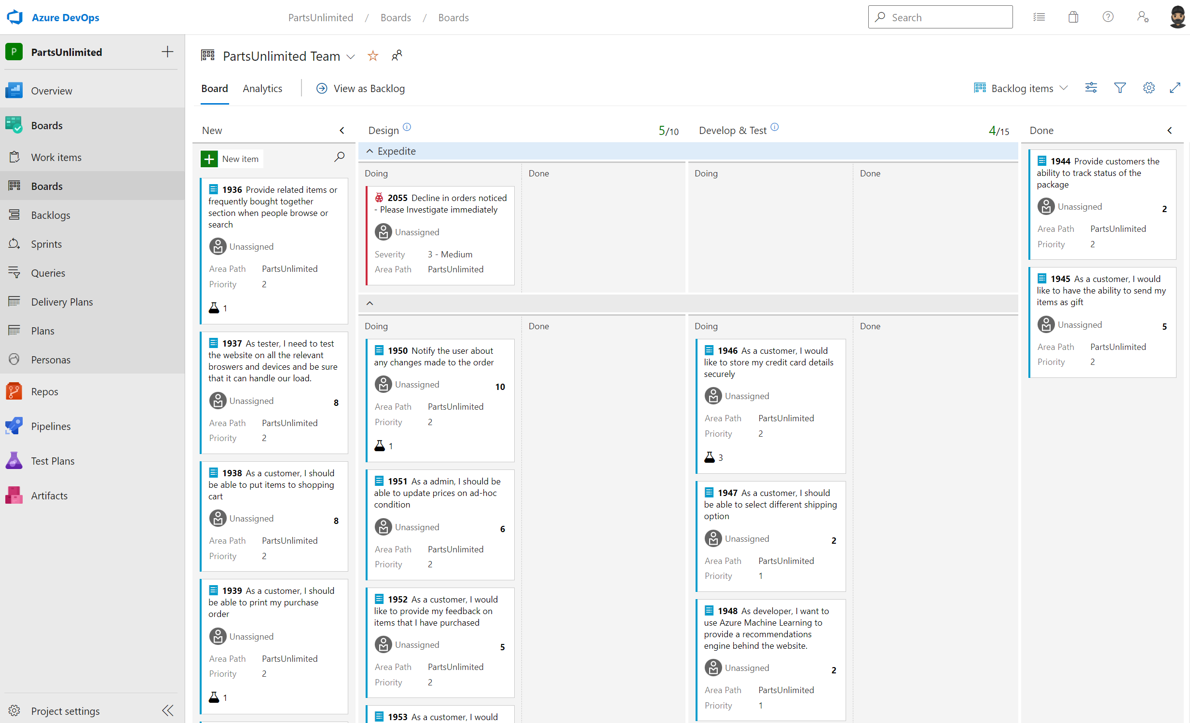
Introduction to Azure Boards
Agile, Scrum, and Kanban processes by default.
Track work, issues, and code defects associated with your project.
Notes:
Explain about Azure Boards and its capabilities.
Azure Boards is a customizable tool to manage software projects supporting Agile, Scrum, and Kanban processes by default.
Track work, issues, and code defects associated with your project. Also, you can create your custom process templates and use them to create a better and more customized experience for your company.
You have multiple features and configurations to support your teams, such as calendar views, configurable dashboards, and integrated reporting.
The Kanban board is one of several tools that allows you to add, update, and filter user stories, bugs, features, and epics.

Slide 18
Configure projects and teams in Azure DevOps
1
Planning:
Analyze organizational structure, operational model, and roles
Determine project scope, objectives, and stakeholders
Identify optimal team structure and roles
Consider defining templates for project structure, processes, and artifacts
2
Implementation:
Specify project’s visibility, version control mechanism, and work item process
Choose between different agile processes
Build team structure, generate area paths, configure additional settings, and manage project resources
Notes:
Planning:

Slide 19
Module 03: Plan Agile with GitHub Projects

Slide 20
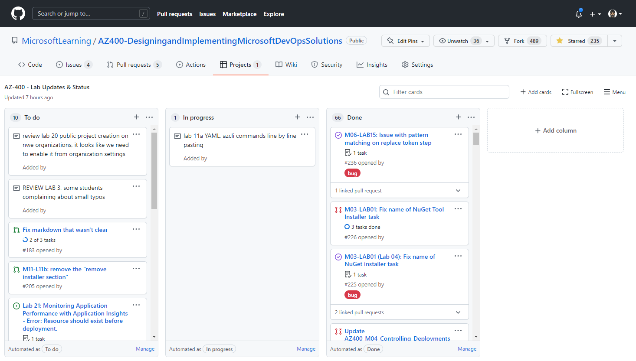
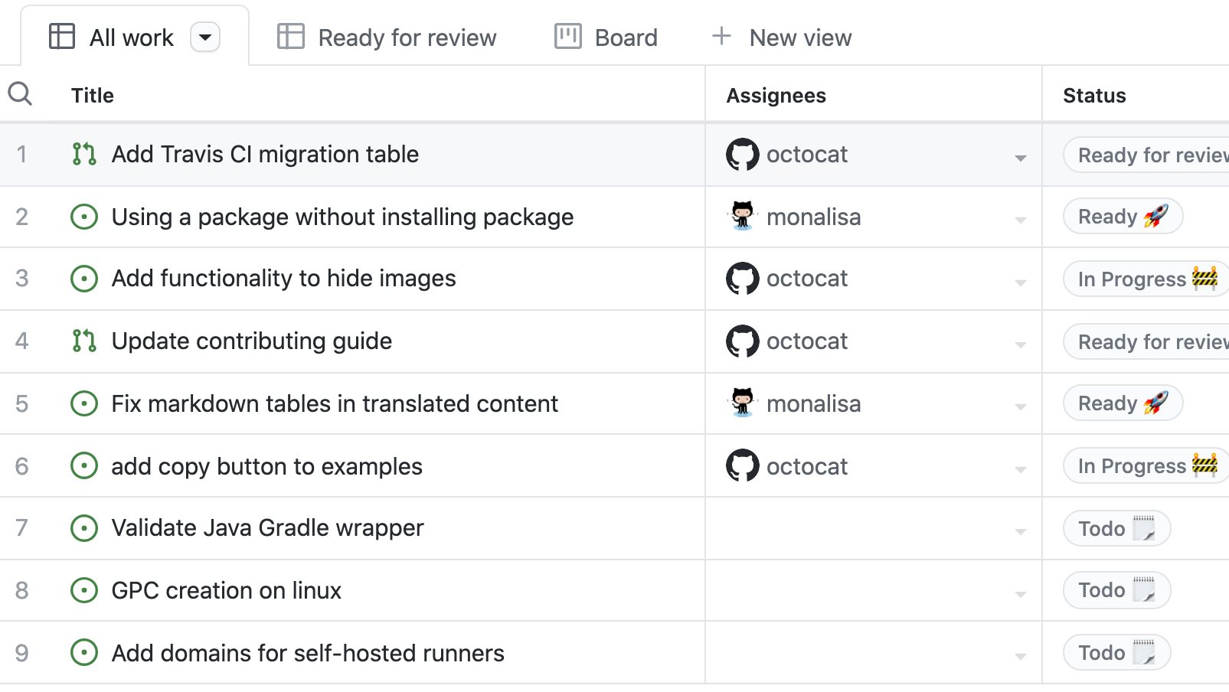
Introduction to GitHub Projects and Project boards
GitHub Project Boards Project boards are made up of issues, pull requests, and notes categorized as cards that you can drag and drop into your chosen columns.
GitHub Projects are a new, customizable and flexible tool version of projects for planning and tracking work on GitHub.
Notes:
Explain GitHub Project Boards and how it controls issues and pull requests. Focus on GitHub Projects and explain this new version has a lot more features and control over the projects.
Projects are a new, customizable and flexible tool version of projects for planning and tracking work on GitHub. A project is a customizable spreadsheet that you can configure the layout by filtering, sorting, and grouping your issues and PRs, and adding custom fields to track metadata. You can use different views such as Board or spreadsheet/table.

Slide 21
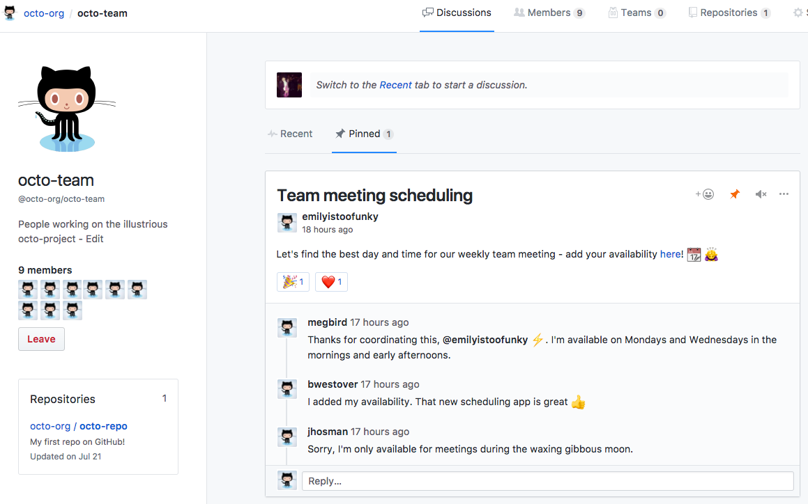
Collaborate using team discussions
GitHub discussions can help make your team plan together, update one another, or talk about any topic.
Across projects or repositories conversations (issues, pull requests, etc.).
Notes:
Explain team discussions.
With team discussions you can:
Post on your team's page or participate in a public discussion.
Link to any team discussion to reference it elsewhere.
Pin important posts to your team's page.
Receive email or web notifications.
Team discussions are available in organizations by default.

Slide 22
Module 04: Source Control

Slide 23
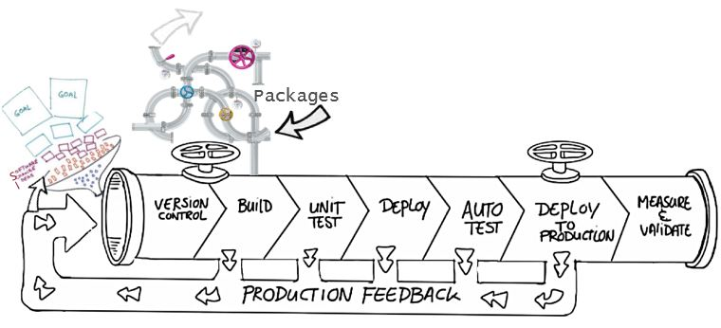
Benefits of source control
Create workflows
Work with versions
Collaboration
Maintains history of changes
Automate tasks
Notes:
Benefits include: Reusability, traceability, manageability, efficiency, collaboration, and learning

Slide 24
Understand centralized source control
Strengths | Best Used for
Easily scales for very large codebases Granular permission control Permits monitoring of usage Allows exclusive file locking | Large integrated codebases Audit and access control down to the file level Hard to merge file types
Centralized
There is a single central copy of your project, and programmers commit their changes to this central copy.
Common centralized source control systems are TFVC, CVS, Subversion (or SVN), and Perforce.

Slide 25
Understand distributed source control
Strengths | Best Used for
Cross platform support An open-source friendly code review model via pull requests Complete offline support Portable history An enthusiastic growing user base | Smaller size (in bytes) and modular codebases Evolving through open-source Highly distributed teams Teams working across platforms Greenfield codebases
Distributed
Every developer clones a copy of a repository and has the full history of the project.
Common distributed source control systems are Mercurial, Git, and Bazaar.
Notes:
A greenfield project is one that lacks constraints imposed by prior work.

Slide 26
Working with Git
DEMO
Notes:
Take a moment to complete the demonstration, as defined in the student manual.

Slide 27
Introduction to Azure Repos
1
Set of version control tools to manage your code:
Tightly integrated with other Azure DevOps features
Can connect from common development environments
Policy based management to protect branches
Offers two styles of version control:
Git: Distributed version control
Team Foundation Version Control (TFVC): Centralized version control

Slide 28
Introduction to GitHub
1
Largest open-source community
2
Features of GitHub:
Automate from code to cloud
Securing software, together
Seamless code review
Code and documentation in one place
Coordinate
Manage teams

Slide 29
Explore branch workflow types
1
Feature branching – All feature development should take place in a dedicated branch instead of the main branch.
2
Forking Workflow – Every developer uses a server-side repository.
3
Evaluate the workflow:
Does this workflow scale with team size?
Is it easy to undo mistakes and errors with this workflow?
Does this workflow impose any new unnecessary cognitive overhead to the team?

Slide 30
Explore feature branch workflow
Create a branch
Add commits
Open a pull request
Discuss and review your code
Deploy
Merge
All feature development should take place in a dedicated branch instead of the main branch.
Encapsulating feature development leverages pull requests, which are a way to initiate discussions around a branch.
Share a feature with others without touching any official code.

Slide 31
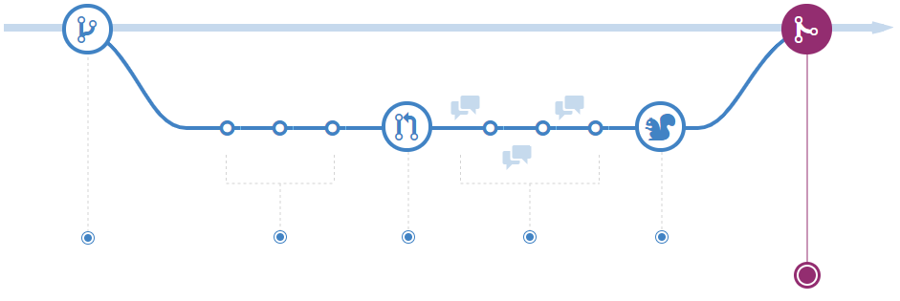
Explore GitHub flow
Make changes
Create a pull request
Delete your branch
Address review comments
Merge your pull request
Create a branch
GitHub Flow is a lightweight, branch-based workflow. The GitHub flow is useful for everyone, not just developers
Notes:
More details: https://docs.microsoft.com/en-us/learn/modules/manage-git-branches-workflows/5-explore-feature-branch-workflow and https://docs.github.com/en/get-started/quickstart/github-flow
Describe the GitHub flow and its steps. From above references:
GitHub is the best tool to enable collaboration in your projects. GitHub flow is a branch-based workflow suggested for GitHub.
To implement GitHub flow, you'll need a GitHub account and a repository. See https://github.com/signup and https://docs.github.com/en/get-started/quickstart/create-a-repo. You can complete all steps of GitHub flow through the GitHub web interface, command line, https://cli.github.com/, or https://desktop.github.com/.
The first step is to create a branch in your repository to work without affecting the default branch, and you give collaborators a chance to review your work. For more information, see https://docs.github.com/en/enterprise-server@3.1/pull-requests/collaborating-with-pull-requests/proposing-changes-to-your-work-with-pull-requests/creating-and-deleting-branches-within-your-repository.
Make any desired changes to the repository. If you make a mistake, you can revert or push extra changes to fix it.
Commit and push your changes to your branch to back up your work to remote storage, giving each commit a descriptive message. Each commit should contain an isolated, complete change making it easy to revert if you take a different approach.
Anyone collaborating with your project can see your work, answer questions, and make suggestions or contributions. Continue to create, commit, and push changes to your branch until you're ready to ask for feedback.
You can make a separate branch for each change to make it easy for reviewers to give feedback or for you to understand the differences. Once you're ready, you can create a pull request to ask collaborators for feedback on your changes. See https://docs.github.com/en/pull-requests/collaborating-with-pull-requests/proposing-changes-to-your-work-with-pull-requests/creating-a-pull-request.
Pull request review is one of the most valuable features of collaboration. You can require approval from your peers and team before merging changes. Also, you can mark it as a draft in case you want early feedback or advice before you complete your changes.
Describe the pull request as much as possible with the suggested changes and what problem you're resolving. You can add images, links, related issues, or any information to document your change and help reviewers understand the PR without opening each file. See https://docs.github.com/en/get-started/writing-on-github/getting-started-with-writing-and-formatting-on-github/basic-writing-and-formatting-syntax and https://docs.github.com/en/issues/tracking-your-work-with-issues/linking-a-pull-request-to-an-issue.
Another way to improve PR quality and documentation and explicitly point something out to the reviewers is to use the comment session area. Also, you can @mention or request a review from specific people or teams.
There are other Pull Requests configurations, such as automatically requesting a review from specific teams or users when a pull request is created or checks to run on pull requests. For more information, see https://docs.github.com/en/pull-requests/collaborating-with-pull-requests/collaborating-on-repositories-with-code-quality-features/about-status-checks and https://docs.github.com/en/repositories/configuring-branches-and-merges-in-your-repository/defining-the-mergeability-of-pull-requests/about-protected-branches.
After the reviewers' comments and checks validation, the changes should be ready to be merged, and they can approve the Pull Request. See https://docs.github.com/en/pull-requests/collaborating-with-pull-requests/incorporating-changes-from-a-pull-request/merging-a-pull-request.
If you have any conflicts, GitHub will inform you to resolve them. https://docs.github.com/en/pull-requests/collaborating-with-pull-requests/addressing-merge-conflicts
After a successful pull request merges, there's no need for the remote branch to stay there. You can delete your branch to prevent others from accidentally using old branches. For more information, see https://docs.github.com/en/repositories/configuring-branches-and-merges-in-your-repository/managing-branches-in-your-repository/deleting-and-restoring-branches-in-a-pull-request
GitHub keeps the commit and merges history if you need to restore or revert your pull request.

Slide 32
Explore fork workflow
1
Forking workflow gives every developer their own server-side repository
2
Each contributor has not one, but two Git repositories: a private local one and a public server-side one
3
Most often seen in public open-source projects
4
Contributions can be integrated without the need for everybody to push to a single central repository
Forked repositories use the standard git clone command

Slide 33
Implement branch merging restrictions
Azure DevOps:
Using branch protection-based policies
Require a minimum number of reviewers
Check for linked work items
Check for comment resolution
Limit merge types
Locking a branch
GitHub:
Using branch protection rules
Require a pull request before merging
Require status checks to pass before merging
Require conversation resolution before merging
Require signed commits
Require deployments to succeed before merging
Notes:
Azure DevOps:
Optionally, you can configure the following constraints:
Build validation: validates code by pre-merging and building pull request changes.
Status checks: require other services to post successful status to complete pull requests.
Automatically include reviewers: designate code reviewers to automatically include when pull requests change certain areas of code.
GitHub
Require linear history
Lock the branch
Do not allow by passing the above settings
Allow force pushes
Allow deletions

Slide 34
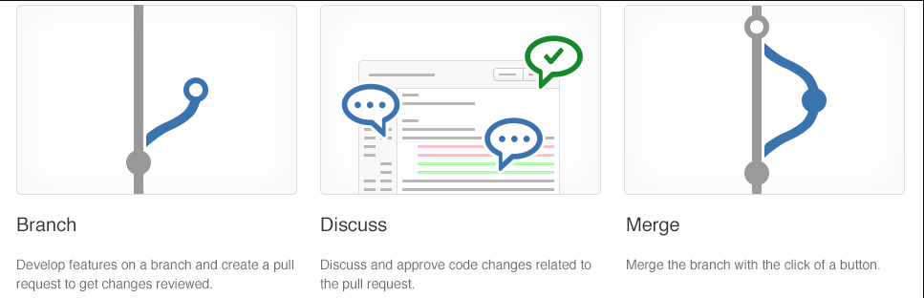
Collaborate with pull requests
Pull requests let you tell others about changes.
Collaboration using the Shared Repository Model
Review and merge your code in a single collaborative process.
Be sure to provide good feedback and protect branches with policies.

Slide 35
Azure Repos collaborating with pull requests
DEMO

Slide 36
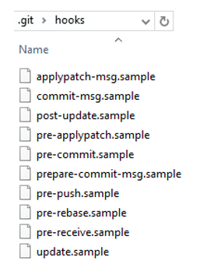
Introduction to Git hooks
A mechanism that allows arbitrary code to be run before, or after, certain Git lifecycle events occur
Use Git hooks to enforce policies, ensure consistency, and control your environment
Can be either client-side or server-side

Slide 37
Implement Git hooks
Will my code:
Break other code?
Introduce code quality issues?
Drop the code coverage?
Take on a new dependency?
Will the incoming code:
Break my code?
Introduce code quality issues?
Drop the code coverage?
Take on a new dependency?

Slide 38
Module 05: Plan foster inner source

Slide 39
Explore foster inner source
1
Fork-based pull request workflows allow anybody to contribute.
2
Inner source brings all the benefits of open-source software development inside your firewall.
3
We recommend the forking workflow for large numbers of casual or occasional committers.

Slide 40
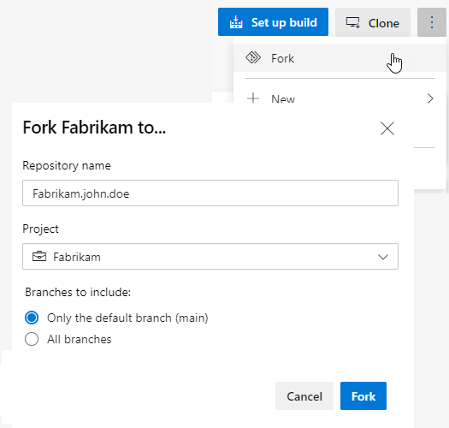
Implement the fork workflow
What’s in a fork?
Sharing code between forks
Choosing between branches and forks
The forking workflow:
Create a fork
Clone it locally
Make your changes locally and push them to a branch
Create and complete a PR to upstream
Sync your fork to the latest from upstream

Slide 41
Module 06: Manage and configure repositories

Slide 42
Work with large repositories
1
Two common causes: Long history and large binary files
2
Long history: Use shallow clones git clone –depth [depth] [clone-url]
3
Large binary files: Use Git Large File Storage (LFS)
Notes:
https://git-lfs.github.com/

Slide 43
Implement Scalar and cross repo when cross repo sharing
Techniques:
Scalar
.NET Core application and Git extension
Caches metadata and uses background maintenance
Cross repository sharing
Reuses code and resources across multiple Git repositories
Key considerations:
Implement Scalar for large repositories
Optimize repository structure
Break down large repositories into smaller ones
Adopt a modular approach
Use Git submodules and Git sub repositories
Register, Pause, Unregister: scalar [register][pause][unregister]
1
2
Run and Clone: scalar [run all], scalar [clone URL]
Notes:
Explain core concepts around Scalar and basic commands.
Scalar is a .NET Core application available for Windows and macOS with tools and extensions for Git to allow very large repositories to maximize your Git command performance.
If Azure Repos hosts your repository, you can clone a repository using the https://github.com/microsoft/VFSForGit/blob/master/Protocol.md. This is how Microsoft supports Windows and Office repositories.
Scalar is a tool that helps Git scale to some of the largest Git repositories. It achieves this by enabling some advanced Git features, such as:
Partial clone: reduces time to get a working repository by not downloading all Git objects right away.
Background prefetch: downloads Git object data from all remotes every hour, reducing the time for foreground git fetch calls.
Sparse-checkout: limits the size of your working directory.
File system monitor: tracks the recently modified files and eliminates the need for Git to scan the entire work tree.
Commit-graph: accelerates commit walks and reachability calculations, speeding up commands like git log.
Multi-pack-index: enables fast object lookups across many pack files.
Incremental repack: Repacks the packed Git data into fewer pack files without disrupting concurrent commands using the multi-pack-index.
Scalar repository: https://github.com/microsoft/scalar
More details about Scalar: https://devblogs.microsoft.com/devops/introducing-scalar/

Slide 44
Implement a change log
1
Track changes to a project over versions.
For each version, record:
New functionality
Changed functionality
Removed functionality
2
Preference is to always avoid dumping log entries into a change log.
Logs are “noisy,” and so it’s easy to generate a mess that is not helpful.
3
Can be manually created
Can be automatically populated
Can be a combination of both
Auto:
git log
gitchangelog
github_changelog_generator
git log [options] vX.X.X..vX.X.Y | helper-script > projectchangelogs/X.X.Y

Slide 45
Purge repository data
Might need to delete files from repository:
Use:
Reduce repository size
Remove accidentally committed large file
Remove committed file with sensitive data (passwords, keys)
git filter-repo tool
BFG Repo-Cleaner
Example:
$ bfg --delete-files file_I_should_not_have_committed
$ bfg --replace-text passwords.txt
Notes:
https://github.com/newren/git-filter-repo/
git filter-branch has a plethora of pitfalls that can produce non-obvious mangling's of the intended history rewrite (and can leave you with little time to investigate such problems since it has such abysmal performance). These safety and performance issues cannot be backward compatibly fixed and as such, its use is not recommended. Please use an alternative history filtering tool such as https://github.com/newren/git-filter-repo.
git filter-repo is a versatile tool for rewriting history, which includes https://github.com/newren/git-filter-repo#design-rationale-behind-filter-repo. It roughly falls into the same space of tool as https://git-scm.com/docs/git-filter-branch but without the capitulation-inducing poor performance, with far more capabilities, and with a design that scales usability-wise beyond trivial rewriting cases. git filter-repo is now recommended by the git project https://github.com/newren/git-filter-repo instead of git filter-branch.

Slide 46
Recover specific data by using Git commands
Recovering commits:
git logs
git checkout <commit>
git cherry-pick <commit>
Recovering specific lines of code:
git blame <file>
git show <commit>:<file>
Recovering files:
git checkout <commit> <file>
git restore <file>
Recovering deleted commits or branches:
git reflog
git fsck—lost-found
Notes:
Remember to use these commands with caution, especially when manipulating commit history or reverting changes. Always make sure to create a backup of your repo before you start or use git stash to save your current changes before attempting any recovery operations.

Slide 47
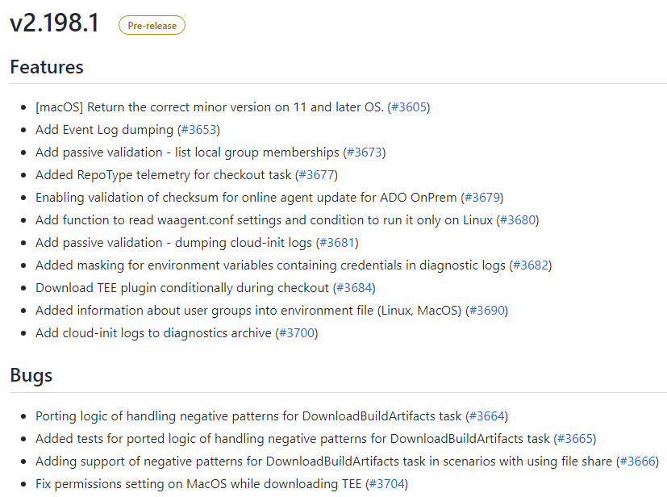
Manage releases with GitHub Repos
Releases in GitHub are based on Git tags.
Tag is a photo of your repository’s current state.
Create a release tag: gh release create tag
To create a prerelease with the specified title and notes: gh release create v1.2.1 --title
Notes:
Explain what a release tag is and how to create using GitHub CLI and Web Browser.
https://docs.github.com/en/repositories/releasing-projects-on-github/about-releases
https://docs.github.com/en/repositories/releasing-projects-on-github/managing-releases-in-a-repository

Slide 48
Configure GitHub tags to organize repositories
Common types of tags
1
Identify the specific commit or release you want to tag. For a commit, copy the commit hash. For a release, copy the release version.
Release versions
Feature releases
Bug fixes
Maintenance releases
Custom tags
2
Use the git tag command line to create a tag: git tag <tag_name><commit_hash>
3
Push the tag to GitHub by running this command: git push origin <tag_name>
4
Verify that the tag has been successfully created by navigating to the Release\Tags page of the repo
Notes:
To assign a tag to a Git repository in GitHub, you can follow these steps:
Identify the specific commit or release that you want to tag in your repository. You can find the commit hash or release version in the commit history or releases section of your repository. If you're tagging a commit, copy the commit hash associated with the commit you want to tag. If you're tagging a release, copy the release version (e.g., "v1.0.0").
In a local clone of the repository, use the git tag command line to create a tag. The basic syntax for creating a tag is git tag <tag_name> <commit_hash>. Replace <tag_name> with the name of your tag and <commit_hash> with the commit hash or release version you copied earlier.
Push the tag to GitHub by running the command git push origin <tag_name>. Replace <tag_name> with the name of the tag you created.
After pushing the tag, you can verify that it has been successfully created by navigating to the Releases\Tags page of your repository on GitHub.
Note that you can create tag protection rules for your repository to prevent contributors from creating or deleting tags. However, keep in mind that, as of March 2024, tag protection rules are in beta and subject to change.

Slide 49
Labs

Slide 50
Lab: Agile planning and portfolio management with Azure Boards
Objectives:
Manage teams, areas, and iterations
Manage work items
Manage sprints and capacity
Customize Kanban boards
Define dashboards
Customize team process
Lab overview:
In this lab you will learn about the agile planning and portfolio management tools and processes provided by Azure Boards and how they can help you quickly plan, manage, and track work across your entire team.
Duration:
Notes:
The labs are updated on a regular basis. For the latest information please visit:
https://microsoftlearning.github.io/AZ400-DesigningandImplementingMicrosoftDevOpsSolutions/

Slide 51
Lab: Version controlling with Git in Azure Repos
Objectives:
Clone an existing repository
Save work with commits
Review history of changes
Work with branches by using Visual Studio Code
Lab overview:
In this lab you will establish and work with a local Git repository, and how to work with branches and repositories in Azure DevOps.
Duration:
Notes:
The labs are updated on a regular basis. For the latest information please visit:
https://microsoftlearning.github.io/AZ400-DesigningandImplementingMicrosoftDevOpsSolutions/

Slide 52
Closing slide

